Slide 1


Zomato Case Study
Presented by Nisha Tripathi

Slide 2

Content
Introduction & Objective
Data Collection
Data Cleaning with Excel Function and
Query
Data Analysis with Query and Insights
Recommendations

Slide 3

Introduction
&
Objective

Slide 4
Case Study
The case study consists of 3 datasets. The analysis is done on the Zomato dataset
which includes customer ratings about 9000+ eateries all over the world.
The other two datasets are used for data cleaning.
There are 7 questions that have been created for the analysis.
The first 2 help to decide the location,
the next 3 help to choose the price range, and the last 2 help to
choose the services for the eatery startup.

Slide 5


Objective
Problem
High competition in cities of India's Central Region among
existing eateries serving North Indian cuisine.
Different price range in different cities.
Deciding to provide table reservations or online delivery services city-wise.
Solution
• To analyze and determine
the ideal Cities, Price range,
and Services for an eatery startup providing
North Indian food in India's central region.

Slide 6

Data Collection

Slide 7

The project consist of 3 datasets:
- Zomato
- Country code
- City region
The analysis is done on Zomato with the help of Country code and City region.
Zomato and Country code files were
collected from Kaggle.
City region file was made for
data cleaning purpose.

Slide 8

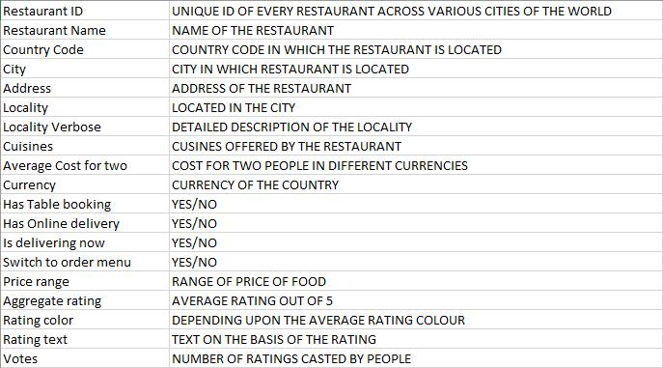

About the datasets
Zomato dataset has 9551 rows And 19 columns
Country code has 15 rows and 2 columns
City Region has 43 rows and 2 columns

Slide 9

Data Cleaning
with Excel Function and Query

Slide 10
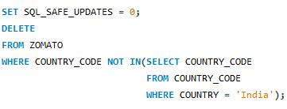
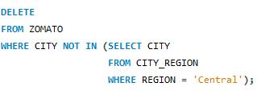

Using the find and replace function in the CSV file, all the "spaces" in the column names have been replaced with "underscores“.
The CSV file is then sent to the pre-created database of MySQL Workbench so that further cleaning can be done using Query
COLUMN NAME | PURPOSE OF CLEANING | QUERY
Country code | The column contains various country codes. For the analysis only country code of 'India' is needed
City | The column contains the names of all the cities from all the regions of India. For the analysis only 'Central' region cities are needed
Cuisines | The column contains all the cuisines. For the analysis only the rows containing 'North Indian' cuisines are needed.

Slide 11

Data Analysis
with Query
and Insights

Slide 12

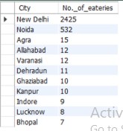
QUERY
Which cities have the
most number of eateries
OUTPUT

Slide 13
FINDINGS
In New Delhi and Noida, there are more eateries.
So, there is fierce competition in these cities.
Agra, Allahabad, Varanasi, Dehradun, Ghaziabad,
Kanpur, Indore, Lucknow, and Bhopal have fewer eateries.
So, there is less competition in these cities.
SOLUTIONS
The eatery startup should concentrate
on opening in cities with less competition.

Slide 14
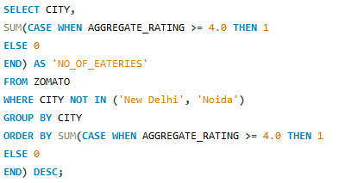
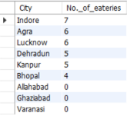
Which low-competition cities have the most eateries with aggregated ratings more than 4?
QUERY
OUTPUT

Slide 15
Findings
There are no eateries in Allahabad, Varanasi, or Ghaziabad
with high aggregate ratings
The number of eateries with high aggregate ratings is about
the same in the other six low-competition cities.
Solution
To fill the need for a high-quality eateries, the eatery startup
should concentrate on opening in Allahabad, Varanasi,
and Ghaziabad.

Slide 16
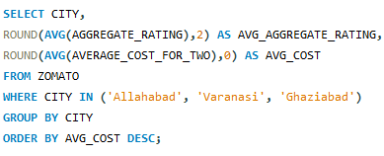

What is the relationship between the Aggregate rating and the Average cost for two people at eateries in Allahabad, Varanasi, and Ghaziabad?
QUERY
OUTPUT

Slide 17
FINDINGS
Ghaziabad has the lowest average aggregate rating
and the highest average cost for two people in eateries.
Comparatively, Varanasi and Allahabad have higher average
aggregate ratings and lower average cost for two people in eateries.
SOLUTION
• The eatery startup should launch a budget-friendly
outlet in Ghaziabad, and comparably pricey outlets in
Varanasi and Allahabad.

Slide 18
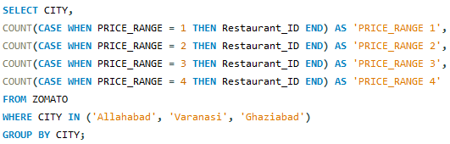

How many eateries have a price range of 1, 2, 3, or 4 in Allahabad, Varanasi, and Ghaziabad?
QUERY
OUTPUT

Slide 19
FINDINGS
Allahabad has most of its eateries in Price Range 3.
Ghaziabad has most of its eateries in Price Range 2.
Varanasi has most of its eateries in Price Range 4.
Solutions
The Price Range of the eatery startup should be 3 in
Allahabad and Varanasi.
The Price Range of the eatery startup should be 1 in Ghaziabad.

Slide 20
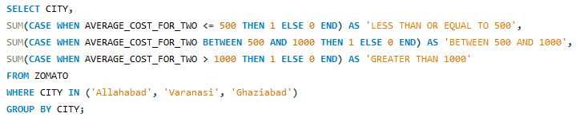

How many eateries have an average cost for two people of less than Rs. 500, between Rs. 500 and Rs. 1000, and more than Rs. 1000 in Allahabad, Varanasi, and Ghaziabad?
QUERY
OUTPUT

Slide 21
FINDINGS
Very few eateries in Ghaziabad and Varanasi
charge more than Rs. 1000 for two people,
while there are none in Allahabad.
Allahabad and Ghaziabad have the most eateries
which cost between Rs. 500 and Rs.1000 for two people.
Ghaziabad And Allahabad has the most eateries which cost
between Rs. 500 and Rs.1000 and less than Rs. 500 for two people.
SOLUTIONS
The eatery startup should have the price of its items
between Rs. 500 and Rs. 1000 in Allahabad and Varanasi.
In Ghaziabad, it should have the majority of items that
are priced less than or equal to Rs. 500.

Slide 22
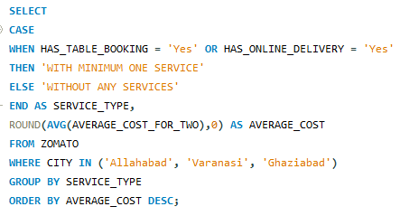

How do eateries with table booking or online delivery services compare in terms of pricing with eateries that do not offer these services in Allahabad, Varanasi, and Ghaziabad?
QUERY
OUTPUT

Slide 23
FINDINGS
The average cost of eating is low in eateries that do not provide
any in Allahabad, Varanasi, and Ghaziabad.
The average cost of eating is significantly greater in eateries that
provide minimum one service between Table booking and Online
delivery in Allahabad, Varanasi, and Ghaziabad.
SOLUTIONS
The eatery startup should provide either Table booking or Online
delivery service in Allahabad, Varanasi, and Ghaziabad.

Slide 24
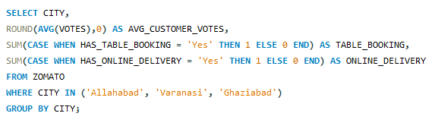
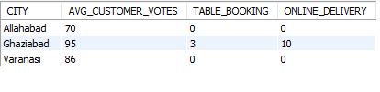
How many eateries offer Online delivery or Table booking service and what are their average consumer votes in Allahabad, Varanasi, and Ghaziabad?
QUERY
OUTPUT

Slide 25
Findings
• Eateries in Ghaziabad offer Table booking and Online delivery
services hence the average consumer vote is much higher than in
Allahabad and Varanasi.
Solutions
The eatery startup should provide both services in
Allahabad and Varanasi.
In Ghaziabad, the company can provide either
Table booking or Online delivery service.

Slide 26
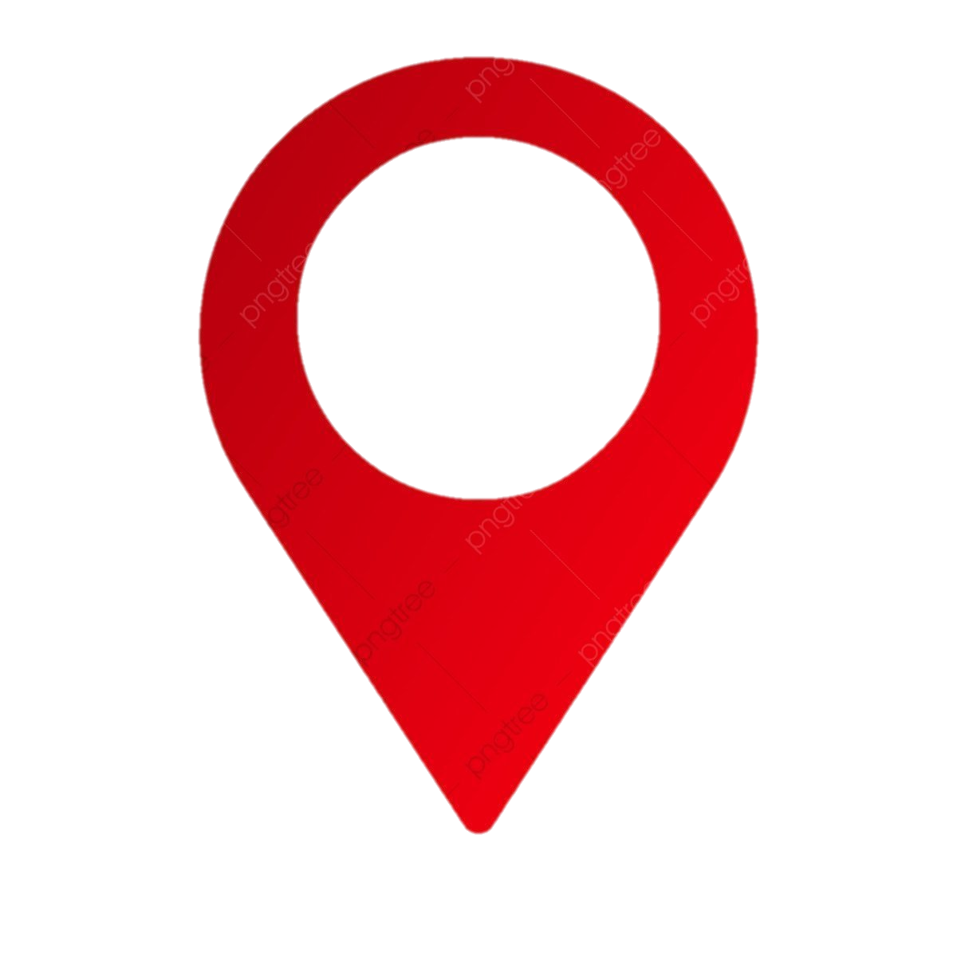

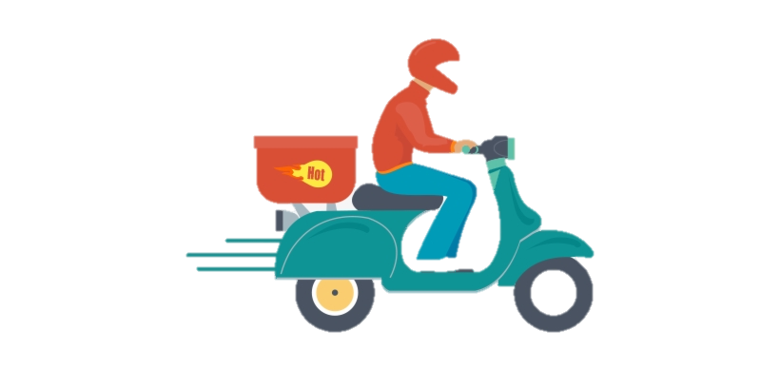
Recommendations
To meet the need for high-quality
eateries, the eatery startup should
focus on opening in low-competition cities such as Allahabad, Varanasi
and Ghaziabad.
The eatery startup should
open a budget-friendly outlet
in Ghaziabad, and comparably
pricey outlets in Varanasi and
Allahabad. The average cost
of eating for two should not
exceed Rs. 1000.
The eatery startup should provide both
Table booking and Online delivery services in
Allahabad and Varanasi, and a minimum of
one service in Ghaziabad.

Slide 27

THANK YOU

